Slide 1
ARM 9 and Zync 7000s SoC

Slide 2
Introduction to ARM 9
ARM9 is a group of older 32-bit RISC ARM processor cores licensed by ARM Holdings for microcontroller use.
The ARM9 core family consists of ARM9TDMI, ARM940T, ARM9E-S, ARM966E-S, ARM920T, ARM922T, ARM946E-S, ARM9EJ-S, ARM926EJ-S, ARM968E-S, ARM996HS.
Since ARM9 cores were released from 1998 to 2006, they are no longer recommended for new IC designs, instead ARM Cortex-A, ARM Cortex-M, ARM Cortex-R cores are preferred.

Slide 3
Overview of ARM9
With this design generation, ARM moved from a von Neumann architecture (Princeton architecture) to a (modified; meaning split cache) Harvard architecture with separate instruction and data buses (and caches), significantly increasing its potential speed.

Slide 4
Most silicon chips integrating these cores will package them as modified Harvard architecture chips, combining the two address buses on the other side of separated CPU caches and tightly coupled memories. There are two subfamilies, implementing different ARM architecture versions.

Slide 5
Differences from ARM7 cores
Key improvements over ARM7 cores, enabled by spending more transistors, include: Decreased heat production and lower overheating risk.
Clock frequency improvements. Shifting from a three-stage pipeline to a five-stage one lets the clock speed be approximately doubled, on the same silicon fabrication process.

Slide 6
Cycle count improvements. Many unmodified ARM7 binaries were measured as taking about 30% fewer cycles to execute on ARM9 cores. Key improvements include:
Faster loads and stores; many instructions now cost just one cycle. This is helped by both the modified Harvard architecture (reducing bus and cache contention) and the new pipeline stages.
Exposing pipeline interlocks, enabling compiler optimizations to reduce blockage between stages.

Slide 7
Additionally, some ARM9 cores incorporate "Enhanced DSP" instructions, such as a multiply-accumulate, to support more efficient implementations of digital signal processing algorithms.

Slide 8
Switching from a von Neumann architecture entailed using a non-unified cache, so that instruction fetches do not evict data (and vice versa). ARM9 cores have separate data and address bus signals, which chip designers use in various ways.
In most cases they connect at least part of the address space in von Neumann style, used for both instructions and data, usually to an AHB interconnect connecting to a DRAM interface and an External Bus Interface usable with NOR flash memory. Such hybrids are no longer pure Harvard architecture processors.

Slide 9
Cores in ARM 9
The ARM MPCore family of multicore processors support software written using either the asymmetric (AMP) or symmetric (SMP) multiprocessor programming paradigms.
For AMP development, each central processing unit within the MPCore may be viewed as an independent processor and as such can follow traditional single processor development strategies

Slide 10
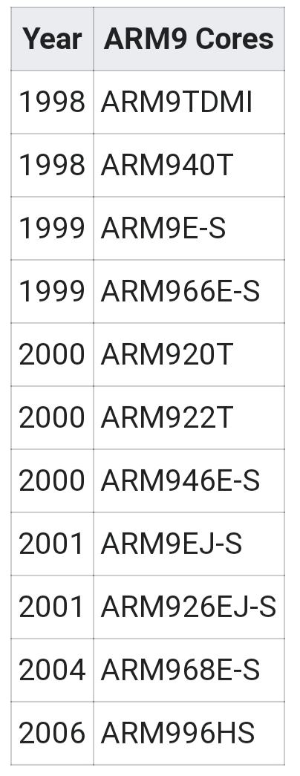

Slide 11
ARM9TDMI
ARM9TDMI is a successor to the popular ARM7TDMI core, and is also based on the ARMv4T architecture. Cores based on it support both 32-bit ARM and 16-bit Thumb instruction sets and include:
ARM920T with 16 KB each of I/D cache and an MMU
ARM922T with 8 KB each of I/D cache and an MMU
ARM940T with cache and a Memory Protection Unit (MPU)

Slide 12
ARM9E-S and ARM9EJ-S
ARM9E, and its ARM9EJ sibling, implement the basic ARM9TDMI pipeline, but add support for the ARMv5TE architecture, which includes some DSP-esque instruction set extensions. In addition, the multiplier unit width has been doubled, halving the time required for most multiplication operations. They support 32-bit, 16-bit, and sometimes 8-bit instruction sets.
ARM926EJ-S with ARM Jazelle technology, which enables the direct execution of 8-bit Java bytecode in hardware, and an MMU
ARM946
ARM966
ARM968

Slide 13
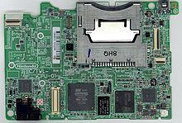
Nintendo DSi has a chip with an ARM9 and ARM7 core

Slide 14
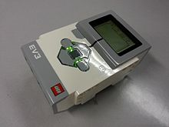
Lego Mindstorms EV3 brick has an ARM9 TI Sitara AM1x

